Slide 1

ESE Web App
Philip Soriano
Subit Paudyal
Juan Jacobo
Rishi Pancholi
Jorge Fuentes

Slide 2
TABLE OF CONTENTS
01
02
03
Site Map
Ideation
User Experience
04
05
Story Board
Data Model

Slide 3

01
Site Map

Slide 4
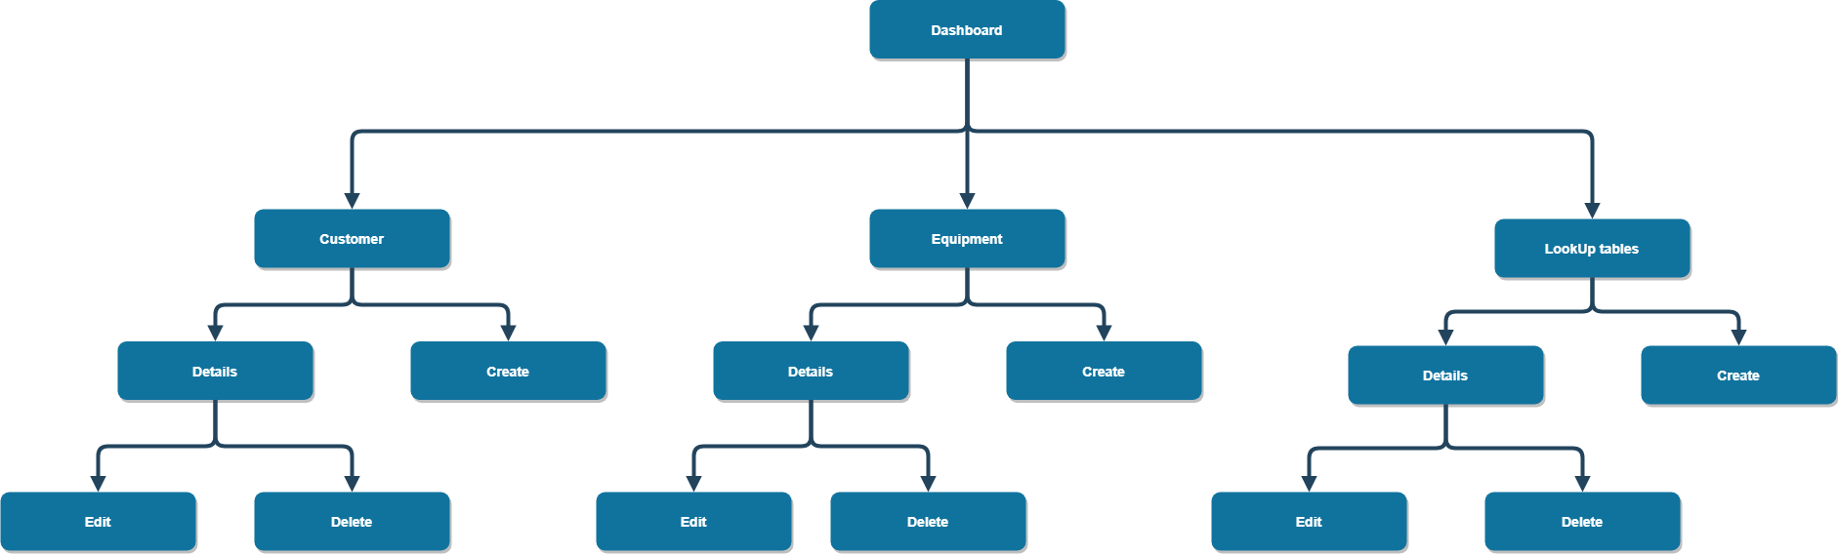

Slide 5

02
Ideation

Slide 6

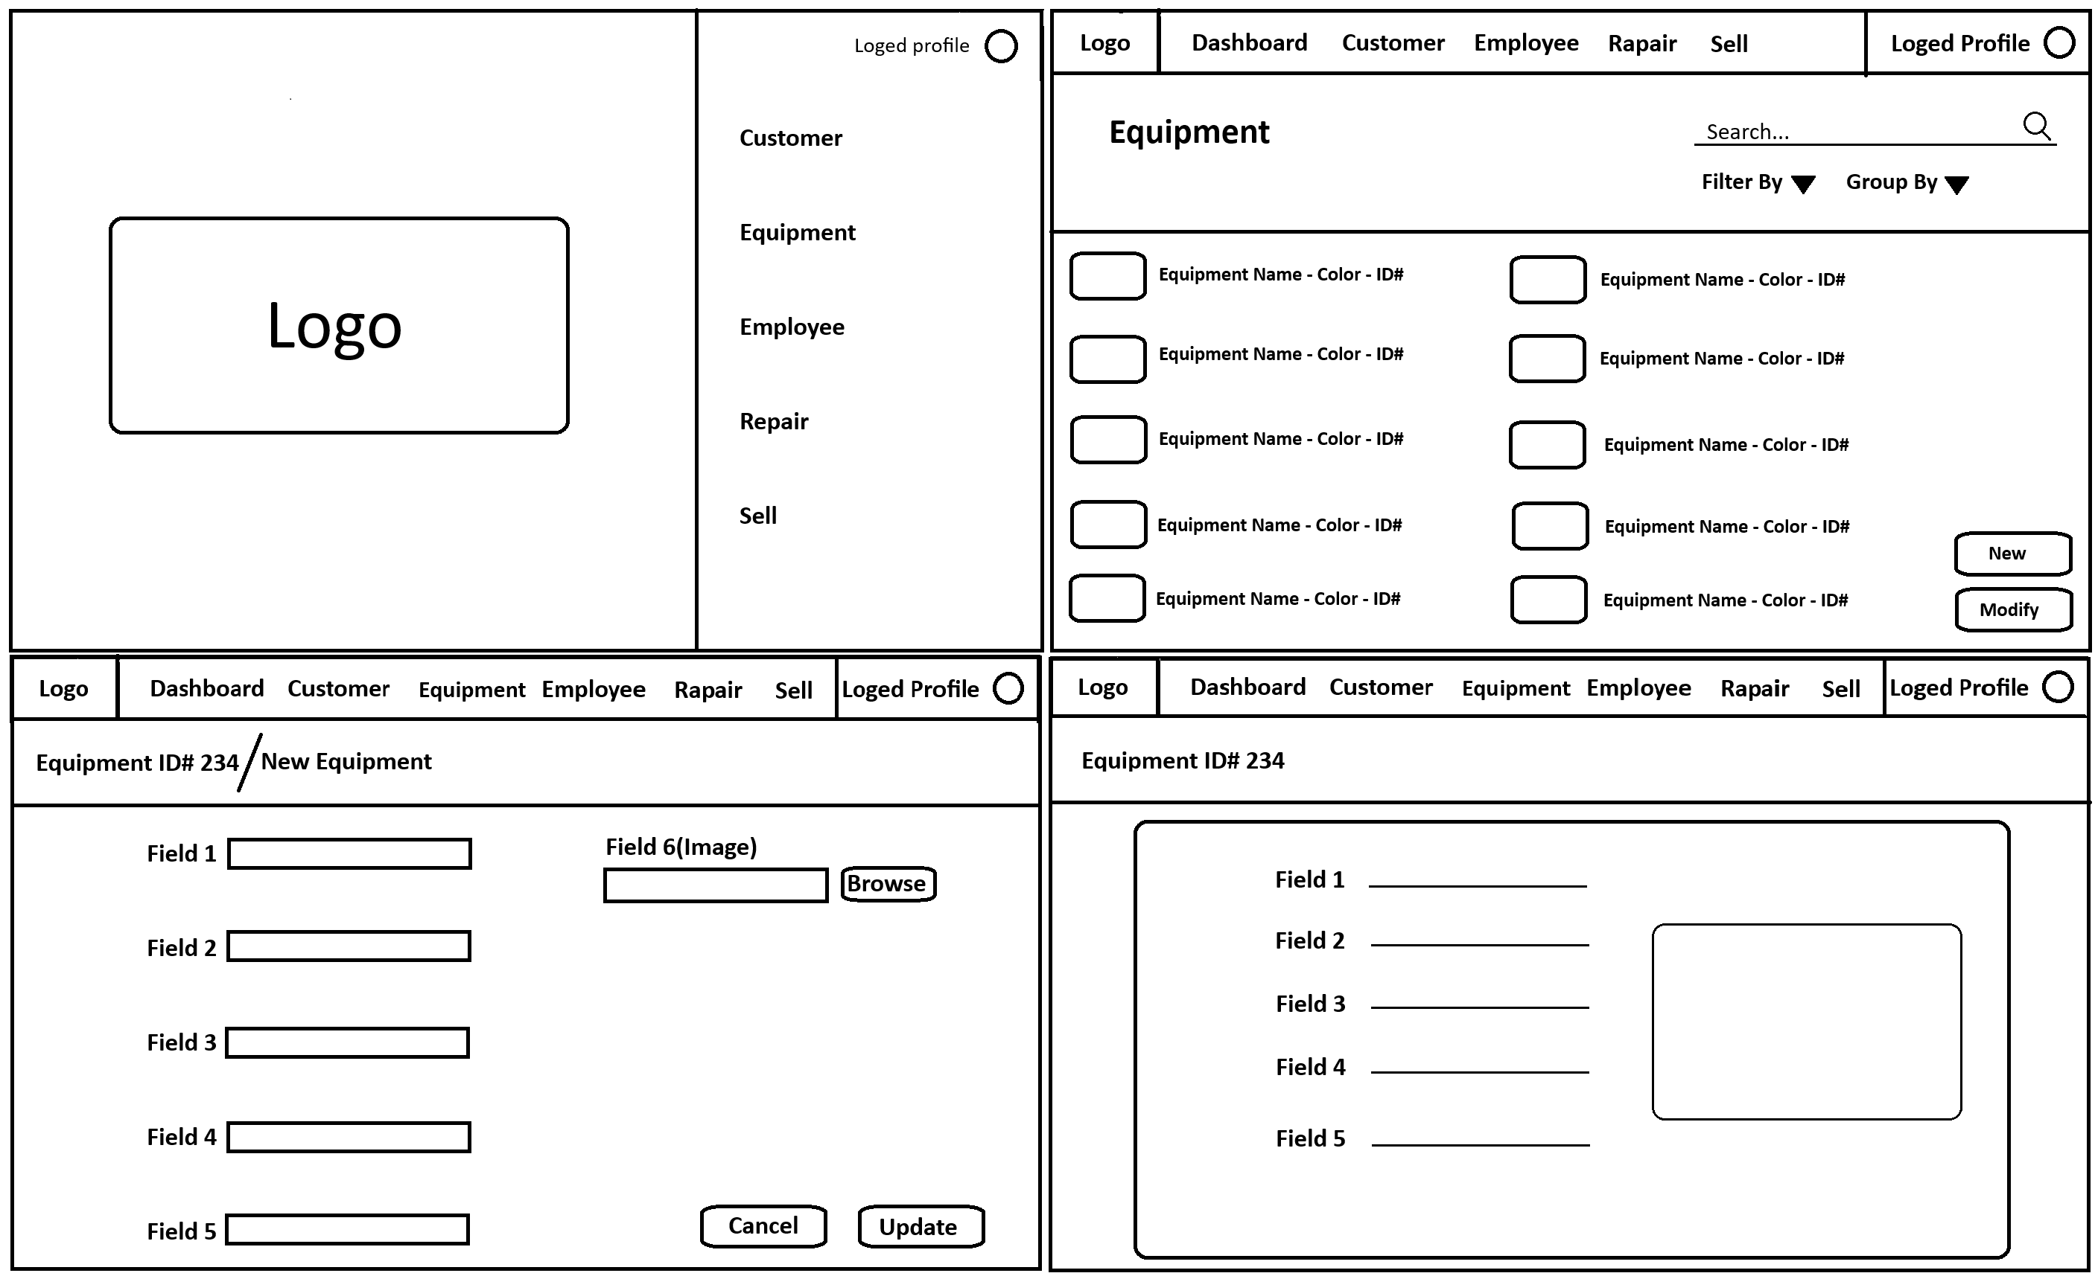

Slide 7

03
User Experience

Slide 8
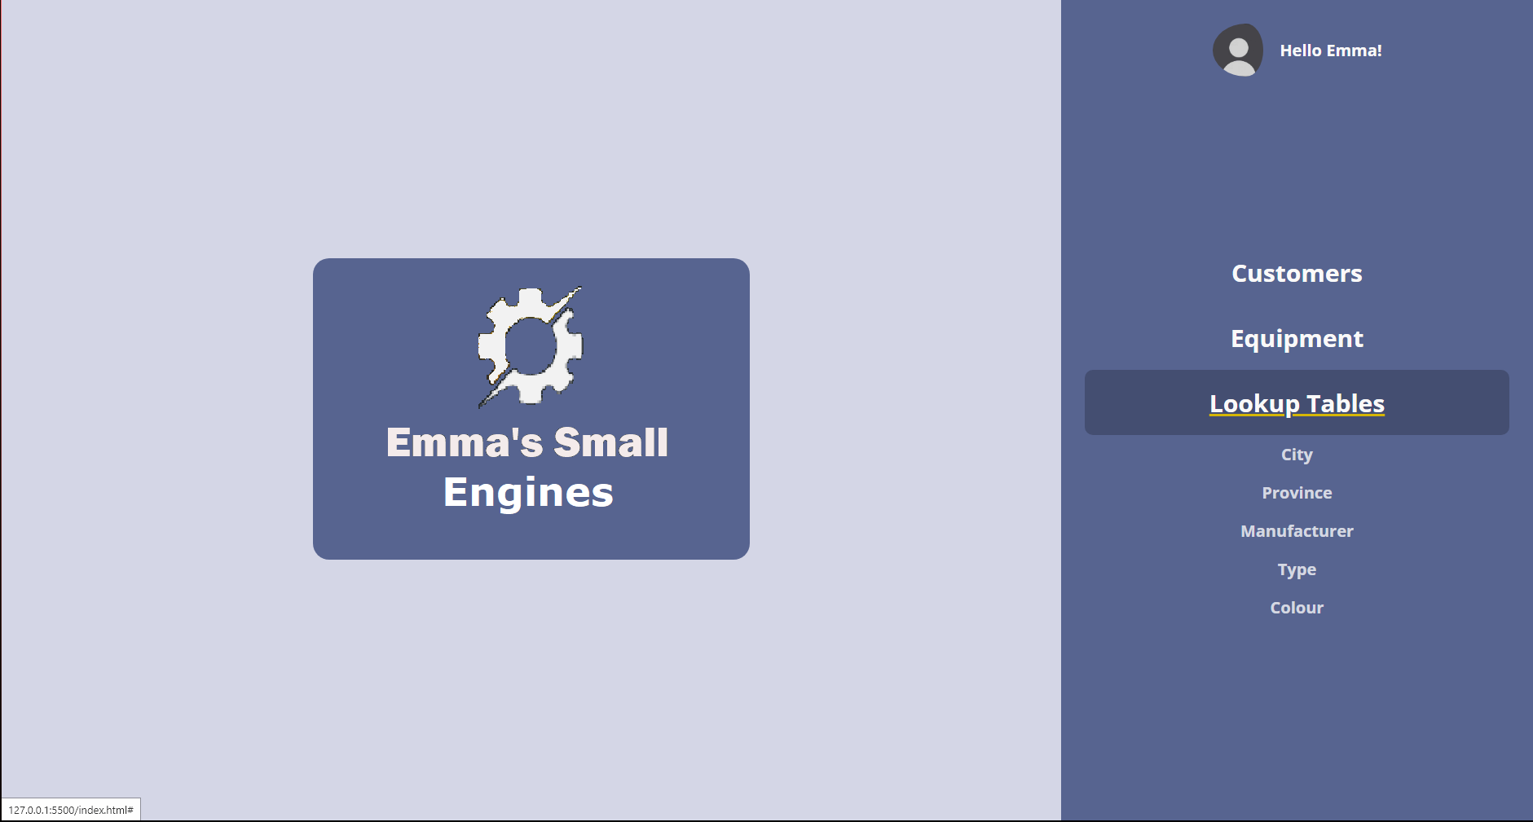

Logged Profile
Navigation Menu

Slide 9
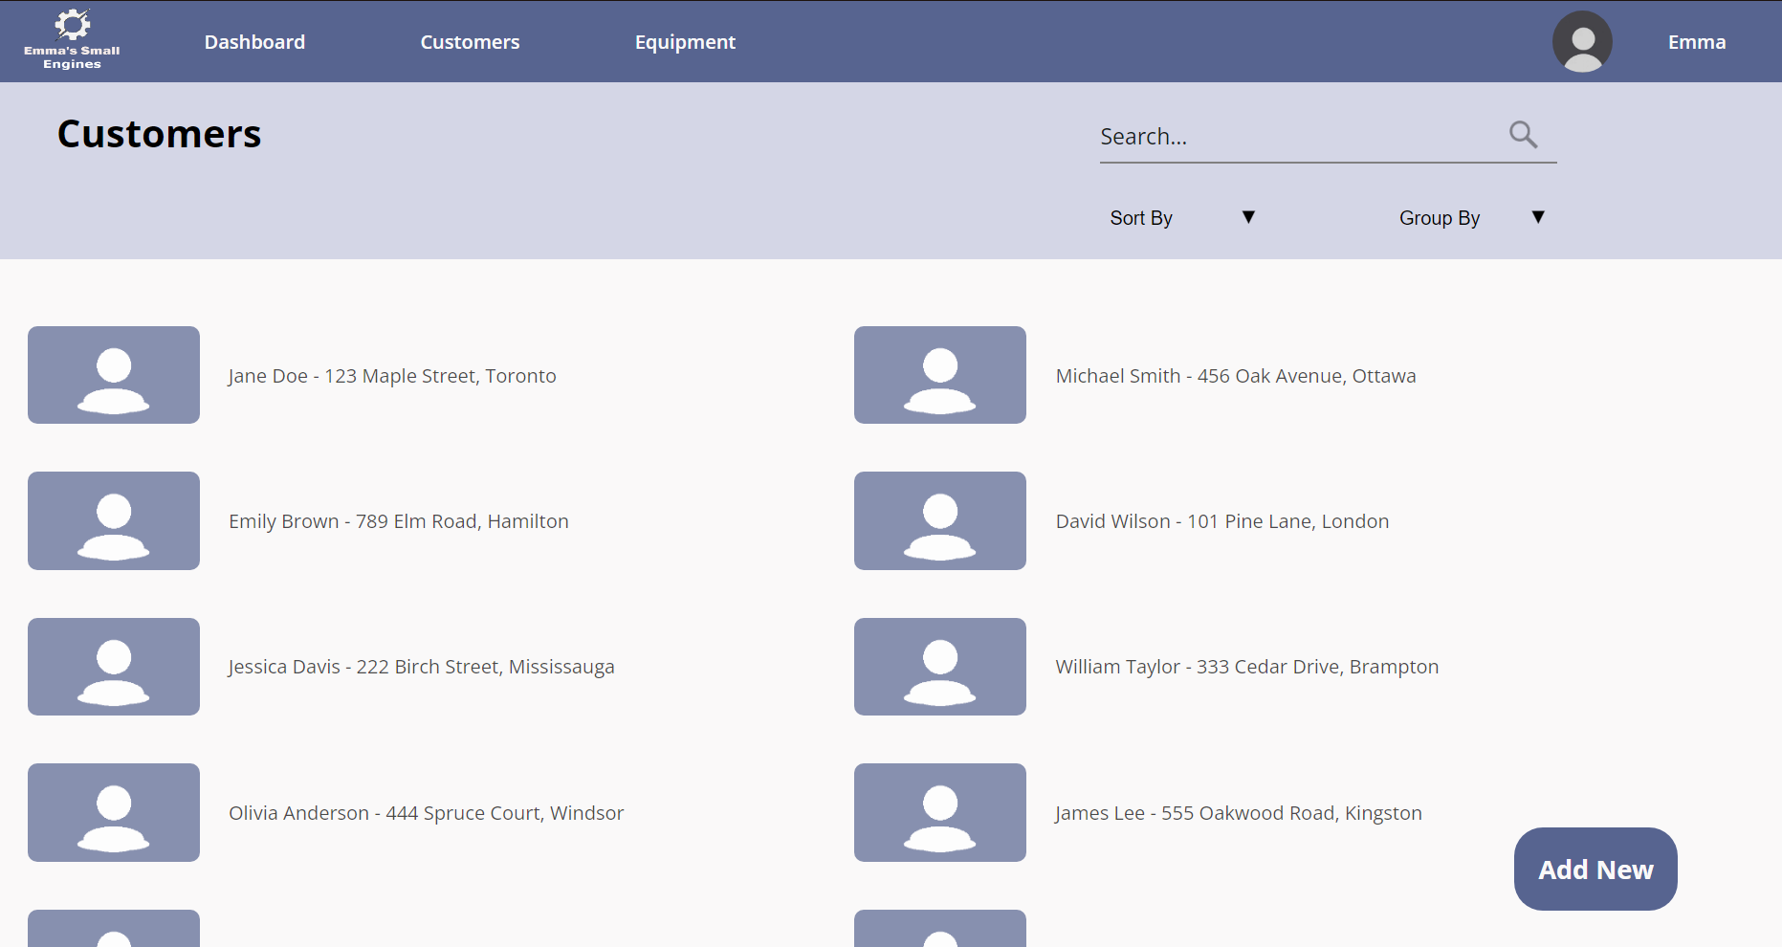
Navigation bar
Profile
Page Title
Filter and Sort
Select one to see the Details
Create new record

Slide 10
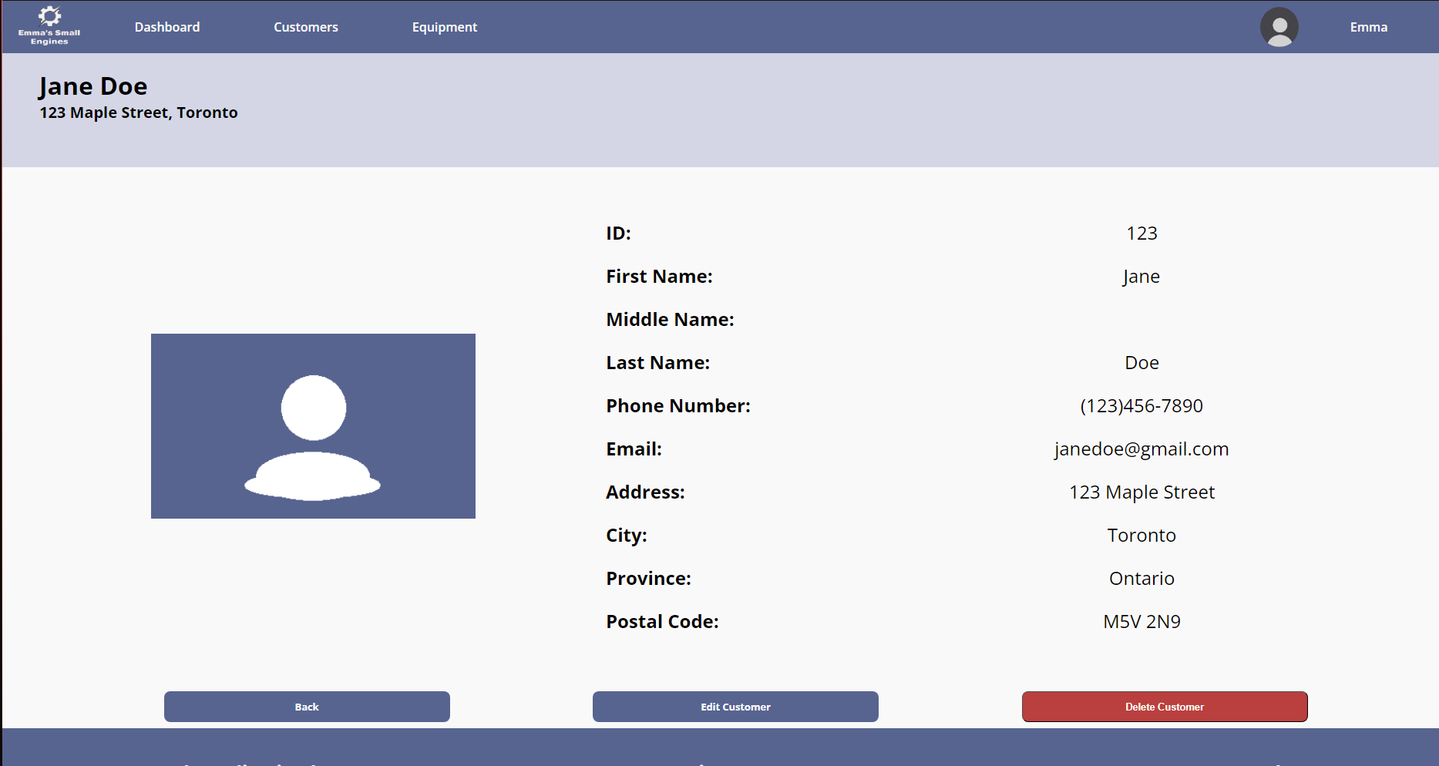

Navigation bar
Profile
Details about record
Record Selected
Go to previous page
Edit Record
Delete Record

Slide 11
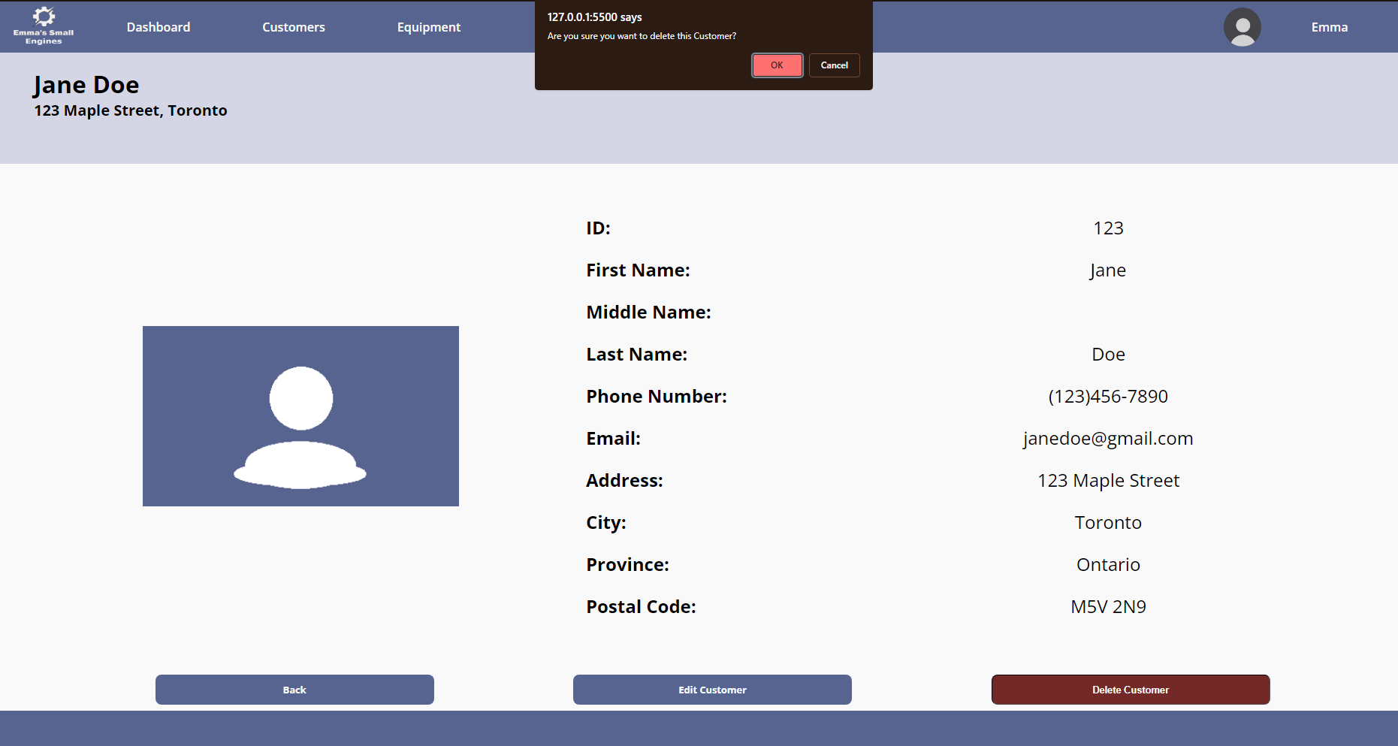
Confirm Delete
Delete Record

Slide 12
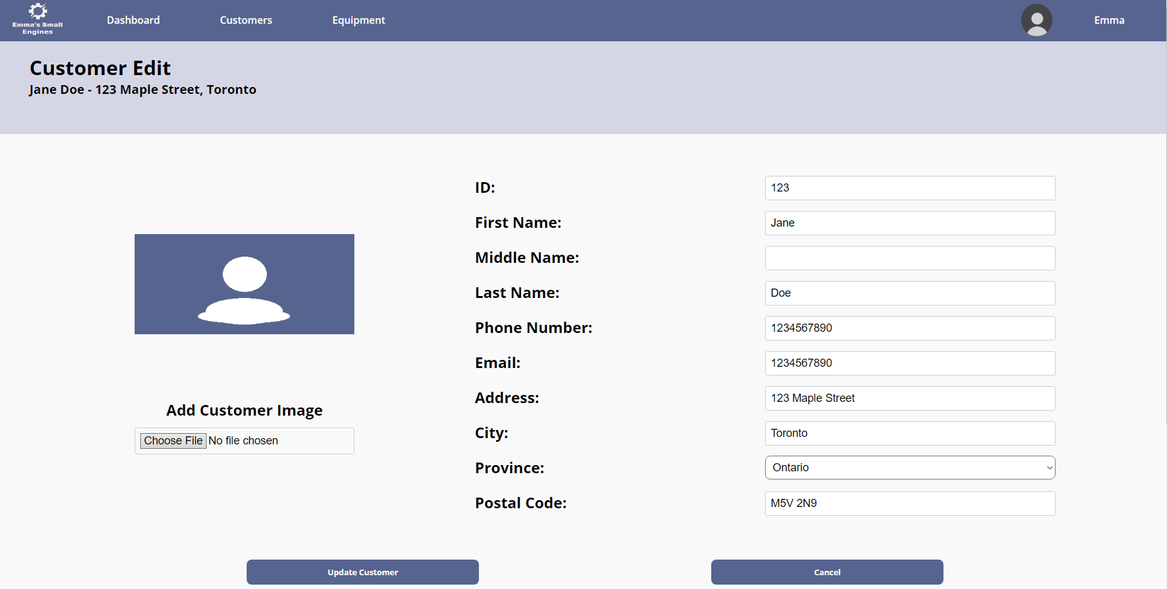
Navigation bar
Profile
Change or insert new Details about record
Record to Edit
Update record
Cancel Update

Slide 13
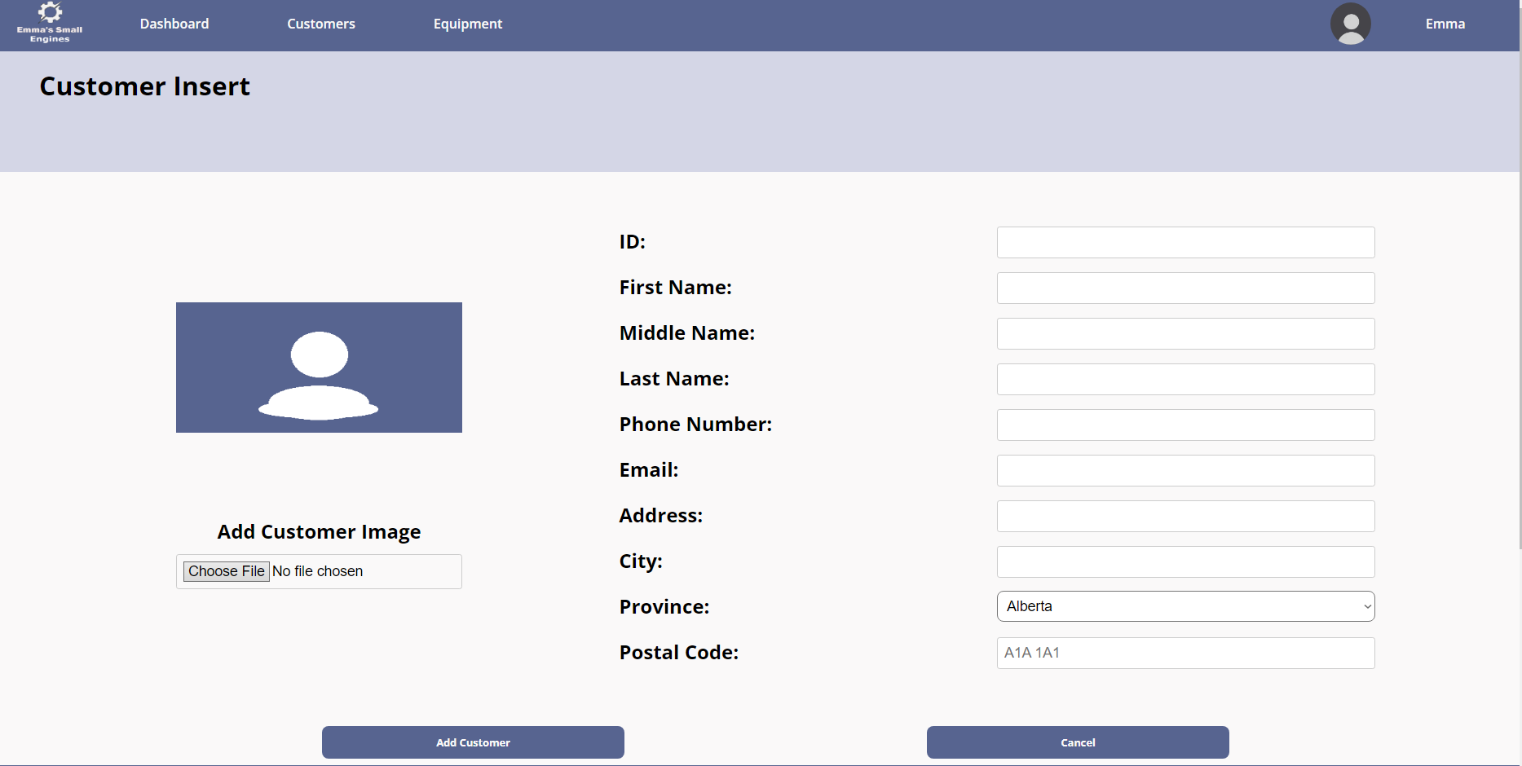
Navigation bar
Profile
Page Title
Insert new record
Create record
Cancel Create

Slide 14

04
Story Board

Slide 15


Customer enters the store
Employee greet the client

Slide 16



Employee search the customer
but couldn’t find them.
Employee asks for Customer details.

Slide 17


Employee asks about the issue.
Customer describes the issue and brings the lawnmower in.

Slide 18


Employee enters the details in system.
Repair order is ready.
Customer leaves the lawnmower for repair.

Slide 19

05
Data Model

Slide 20
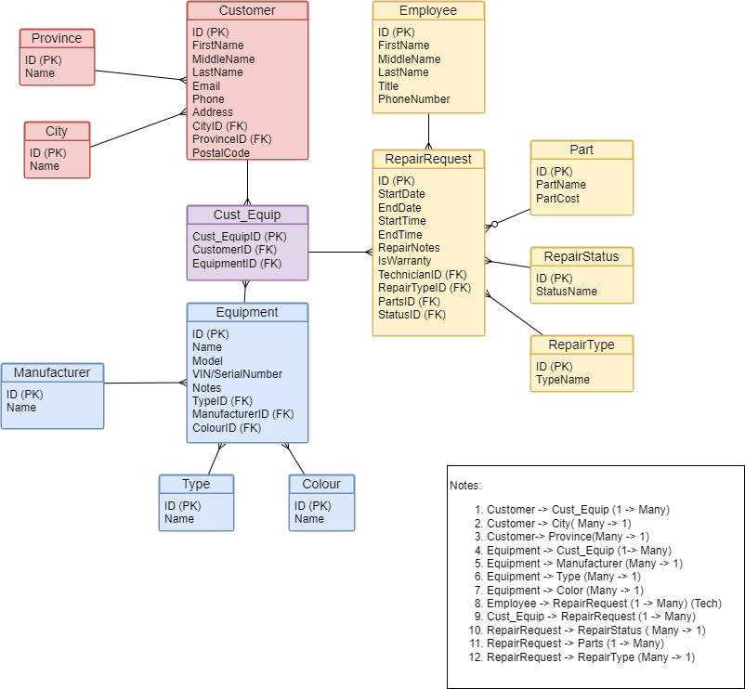

Slide 21


Thanks!

